Slide 1

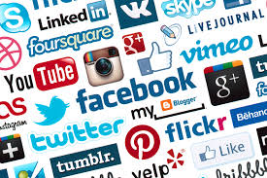

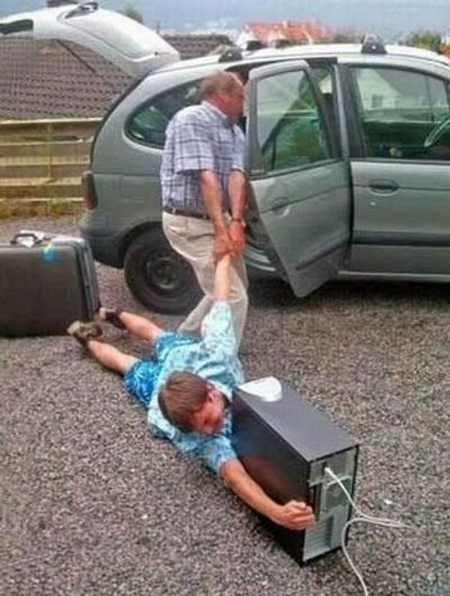
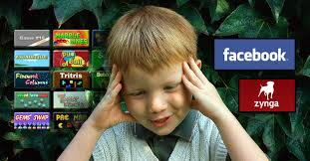
An analysis of Human Behavior on Internet Based Interactions
Ramesh Nadavati, Sai Chaitanya Hanumara
UM-Flint CSEP Department
Methods:
Online survey were sent to nearly 300 people globally and 68 responses were received.
Face to face interview with 7 participants (3 students and 4 professionals) with grouping.
Online surveyed data analyzed using counting, descriptive statistics, T-test from inferential statistics.
A student said “I can create a discussion regarding my school work, camps, etc., also I can increase the communication skills and can meet people around the globe”.
Key findings:
This research indicates that the shy people spend large amounts of time on SNSs.
Spending too much time on chatting and browsing instead of constructive work, and less involved with their real life commitments and communities.
There is a biological thing that happens in the brain when people unveil information about themselves(dopamine increased), that their thoughts are interacting with someone else in mean time, and people accept them instantly, which leads to an addiction.
Introduction:
This research deals with the preliminary study of association between SNS activity and mental health measures.
With the help of social networking sites, information exchange, Socializing and networking was transformed in the technological era.
Social media has dramatically changed the world and the way people communicate.
Nowadays people engaged in computer aided communications more frequently than face to face conversations due to time limits, work pressures, family commitments etc.
Objective:
To identify human behavior while browsing the Internet or SNSs.
To identify emotional problems encountered by SNSs user.
To identify variety of mental state experienced by SNSs user.
Discussions:
A 65 year old real-estate business man ask us “is there any medication to give up SNSs”.
a professional said “I’m a big savvy of internet”.
Conclusion: People are not passively affected by technology, but actively shape its use and influence(Fischer 1992, Hughes & Hans 2001). This study indicates that the most people are feeling too much burden with SNSs and internet usage, we were also asked the users to define their emotions with an emoticon at different levels of their behavior. Currently we are at primary stage of estimating the association between SNSs and mental health measures. More over, there are some unanswered questions theoretically we considered them as “no response”.
Future work: in the future we would like to come up with a system that can authorize the user behavior, emotions continuously and provide suggestions to the user based on current behavior, to increase the mental stability. Our dream is to help the user in order to live healthy and for healthy browsing.

